Slide 1
Freshman Parent and Student Night
Please Log In To PowerSchool

Slide 2
Know your Counselor and AP!

Slide 3
Understanding Your GPA
GPA Calculator

Slide 5
Final Exams are 20% of Your Grade!
December 14th-20th For All State Exams

Slide 6
10 Class Periods Missed = 15 Hours of missed instruction! How much more successful would you be if you had 15 more hours of teacher support?
Tardies: Choose to be on time.
Tardies count EVERY Period, EVERY Day
Once you hit 3 for a class in a month consequences occur
6 Tardies= Full Day ISS
You will get an email each time your child is tardy
Attendance and Tardies

Slide 7
Quick Guide to
Increase Rigor
Actively engage in class
Google is not the answer- Google does not equate to learning
Use your resources! Teachers knowledge, study guides, tutoring, etc.

Slide 9
Viviana Negron
Family Engagement Coordinator
Email: vnegron@wcpss.net
Phone: 919-217-5350
Ext: 24097

Slide 10
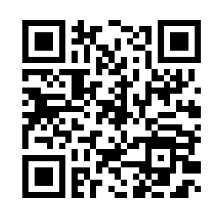
Virtual Parent Workshop Session
Thursday, October 19, 2023 from 6-7pm
Communicating with your Teenager Effectively and How can Students Manage Anxiety in Spanish/English
Register here using the QR Code

Slide 11
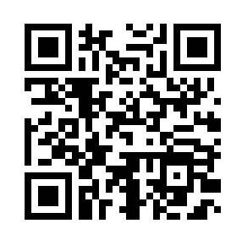
Parent Workshop Session at School
Wednesday, November 29, 2023 from 3-4pm
Information about EOC test, grades, end of the year test and schedule.
Register here using the QR Code

Slide 13
WE WANT TO HEAR FROM YOU!
Knightdale High School families, please take this short survey and let us know how we’re doing. Thank you!
Scan the QR Code above with your phone or visit this website to take the survey:
https://bit.ly/khsfamilysurvey

Slide 14
Breakouts!
How to Help My Student With Math?- Morgan and BP (1613)
CTE Pathways, Internships, Academies- Wright (Design Thinking Lab)
CCP- Hutch/Thomas (Commons)

