Slide 1
Decoding Your Financial Aid Offer
Meghana Giri, KHS College Adviser

Slide 2
Go to linktr.ee/khscollegeadvising to follow along with the slides!
Check in here!

Slide 3
1
What Am I Paying for?
Direct and Indirect costs that make up your bill

Slide 4
How Colleges Generate the Sticker Price
25¢
Direct Costs
Indirect Costs
Tuition
Required Fees
Room
Meals (Board)
Books & Supplies Transportation
Personal & Miscellaneous Loan Fees

Slide 5
Cost of Attendance (COA)
Total amount it costs to attend that school for one year (direct costs + indirect costs), including:
Tuition - cost of taking courses at the school
Room and board - cost of housing and meal plan
Transportation - cost of getting to and from the school for every semester
Books, supplies, miscellaneous personal expenses
“Fees”
Student activities
Recreation facilities
Athletics
Student health and wellness
Transportation

Slide 6
2
How much do I actually pay?
How colleges determine the amount you pay

Slide 7
How Financial Aid is determined
Colleges use FAFSA and/or CSS to determine how much your family can pay and use those to determine your cost
The actual amount you end up paying can be found in the student portal along with any finaid you have been allotted

Slide 8
How Financial Aid is determined
RDS
FAFSA
Colleges take the tuition determined by the RDS and your EFC from the FAFSA to determine how much you pay and how much need based aid you will receive
Determines NC residency and whether you receive in-state or out of state tuition. In state tuition is typically ⅓ of out of state tuition at public universities.
Federal form that uses your parent/legal guardians’ financial info to determine your Estimated Family Contribution (EFC) and gives that amount to the school. Updated once a year.

Slide 9
Different Types of Aid
Need-based Aid
Merit-based Aid
Gift Aid
Self-Help
Grants and loans given based on family finances
Scholarships given based on academic, musical or athletic abilities
Grants and scholarships given by the school that you don’t have to pay back
Employment, work study and loans
Notes:
Grant

Slide 10
**BIGGEST DIFFERENCE
Grants & Scholarships
Loans
You eventually DO have to pay back
You DON’T have to pay back!!
When? Depends on your repayment plan with your loan servicer - can be 10-30 years

Slide 11
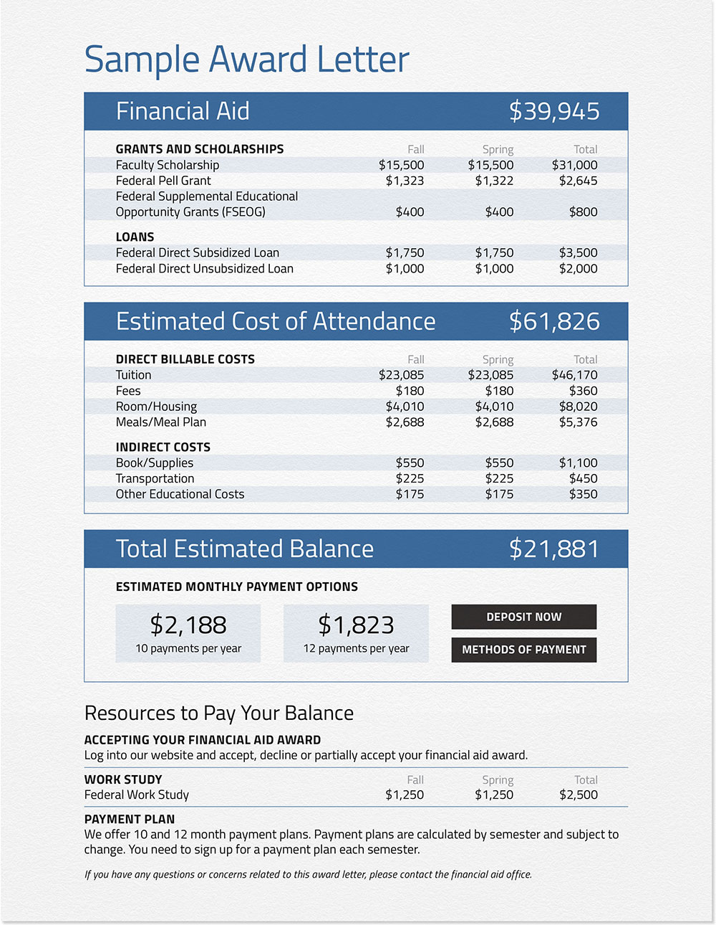

Slide 12
3
Where do I find my bill?
Navigating the online student hub and being able to interpret your bill

Slide 13
The Student Portal
When you are accepted to a college, you receive a student ID, student email and a login that you will be able to use to log in to your college’s student hub

Slide 14
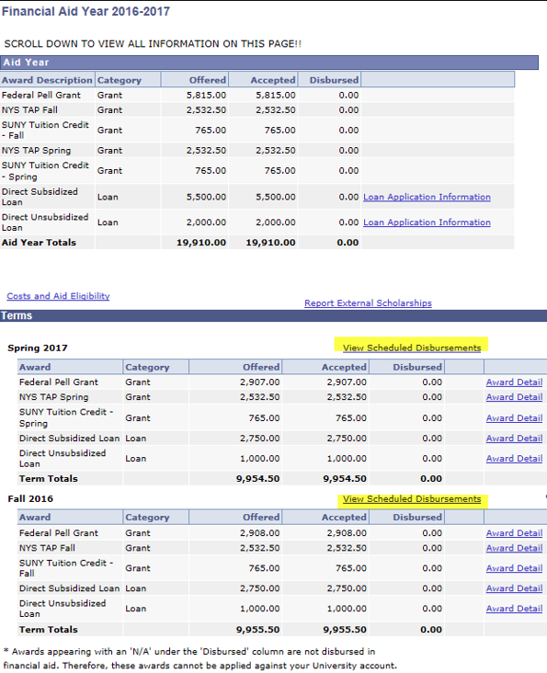
What the Financial Aid tab normally looks like

Slide 15
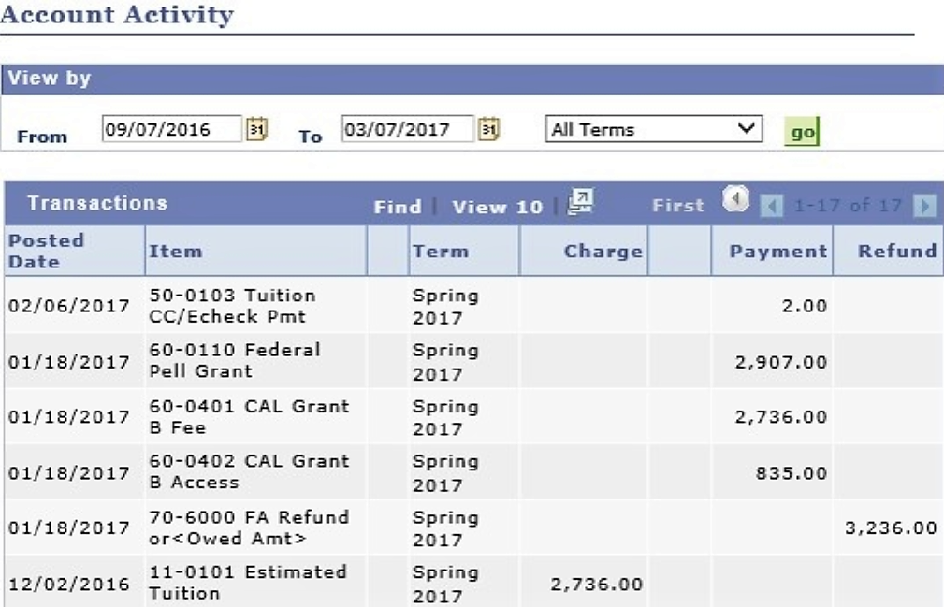
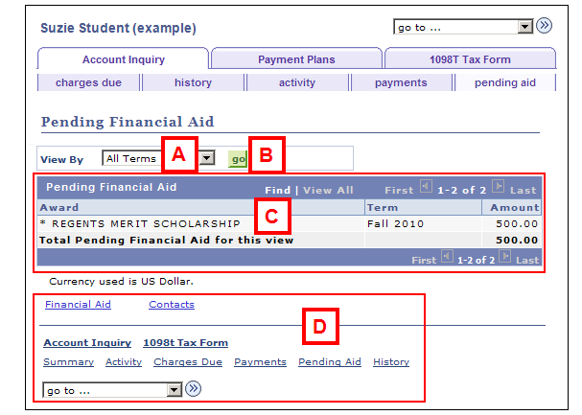
Example of what a bill looks like

Slide 16
4
How do I pay my bill?
Outlining different strategies to pay your bills like scholarships, grants, and loans.

Slide 17
How to deal with the
Estimated Family Contribution
Loans
Employment
Outside Scholarships
Finaid Office

Slide 18
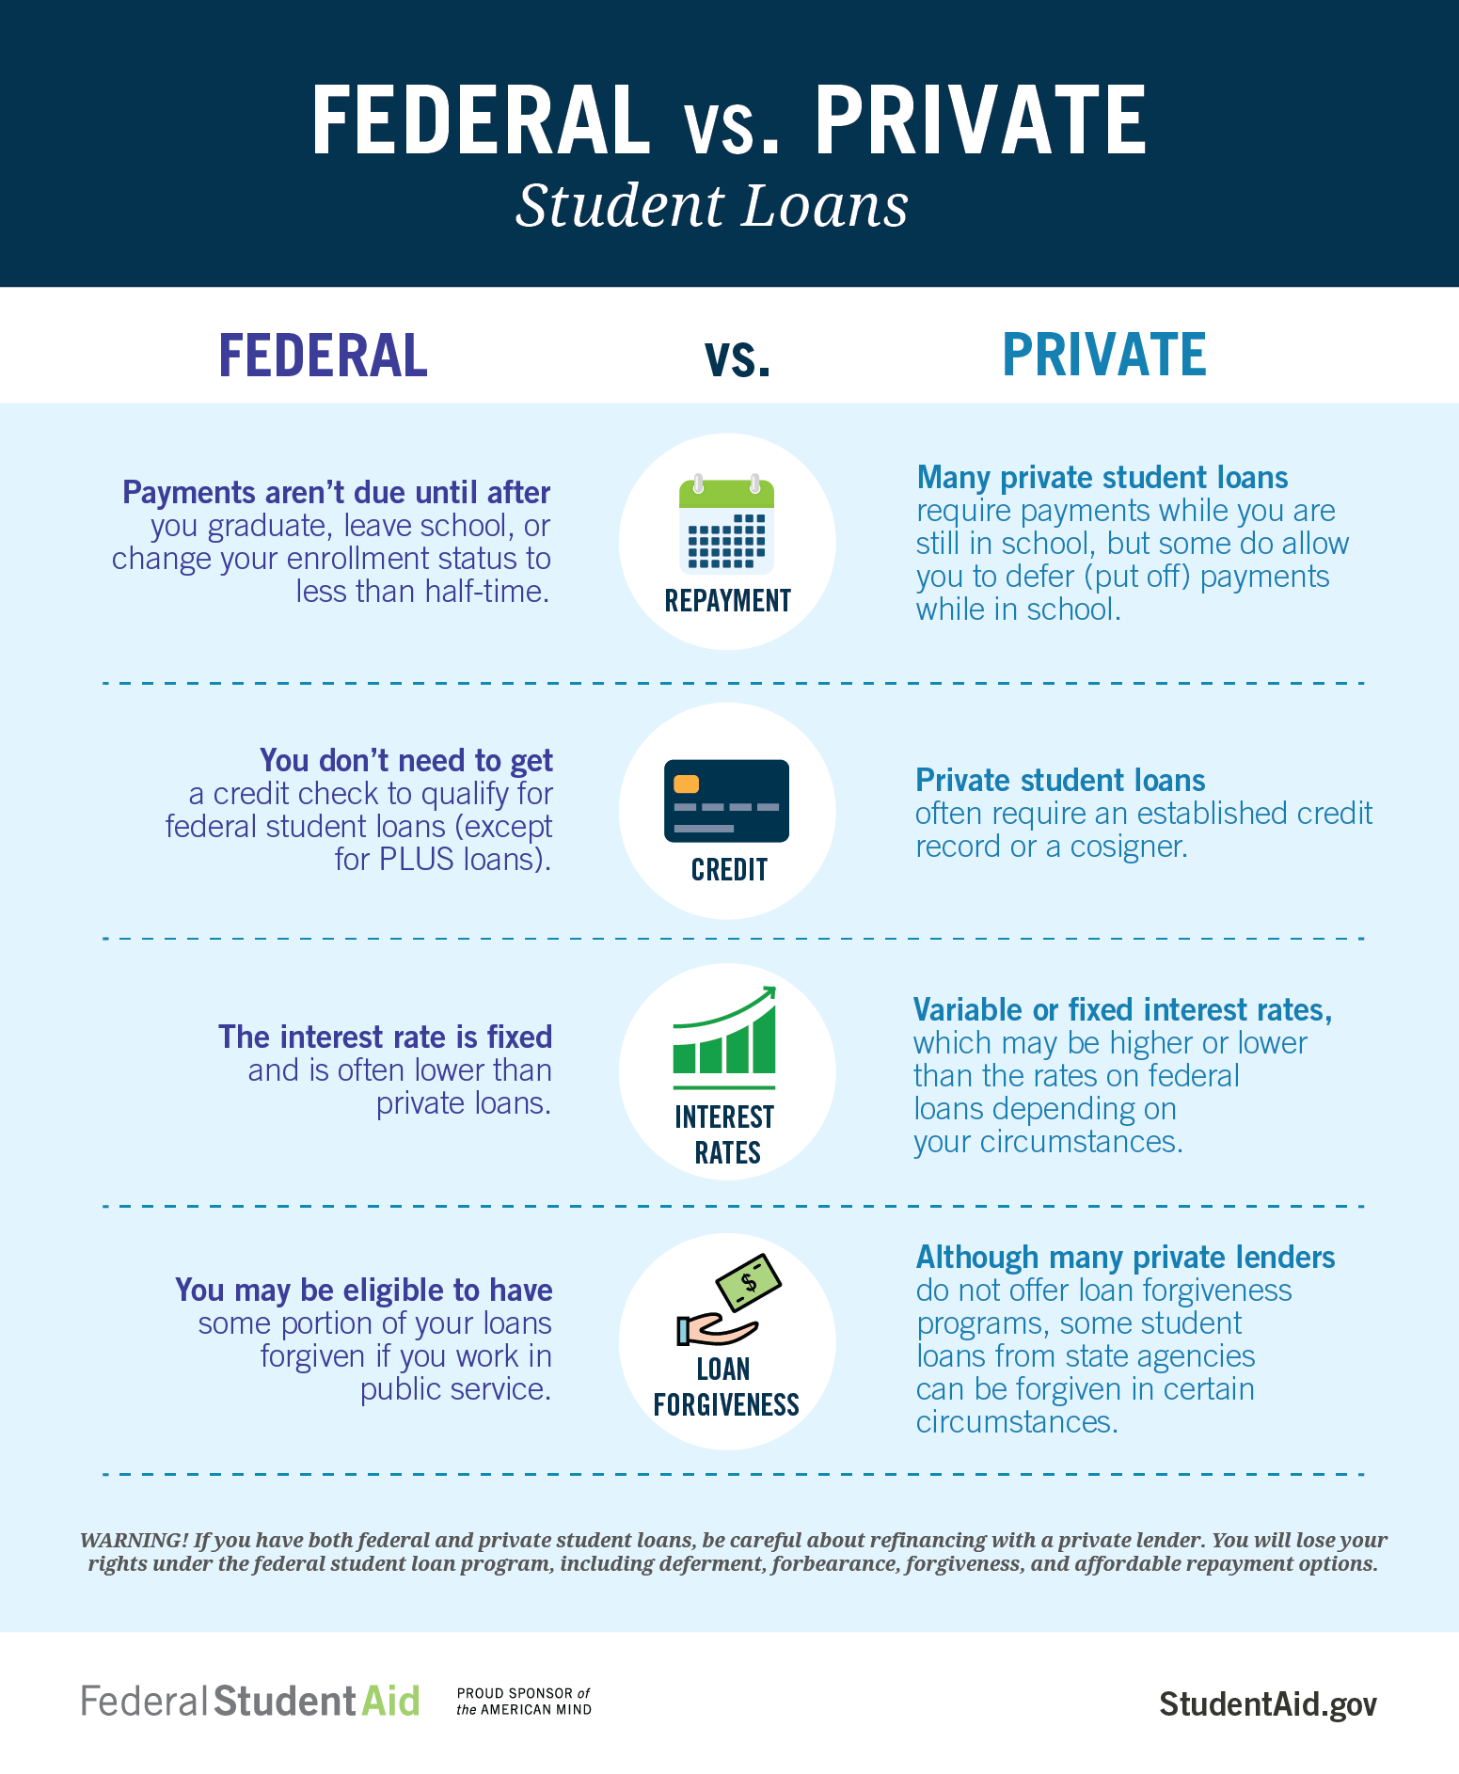
What does this mean?
Unless you already have a really good credit score, then federal loans are probably your best bet

Slide 19
Federal Loans
Direct Subsidized Loans
Interest does NOT add on until 6 months after you graduate from college
Best bet!
Maximize subsidized loans first, and if you still need more money to pay your direct costs, go to unsubsidized next
Direct Unsubsidized Loans
Interest starts adding on the moment you get the loan (when you first start college)
Still a good option, but maximize the subsidized first!

Slide 20
Employment
You can pay out of pocket by finding employment on or off campus. If you qualified for work study it will be easier to find a job on campus.
Work study is the same as a regular job except the school pays you from government funding rather than their own money.

Slide 21
Let’s use my Financial Aid Offer Analyzer to go through an example!

Slide 22
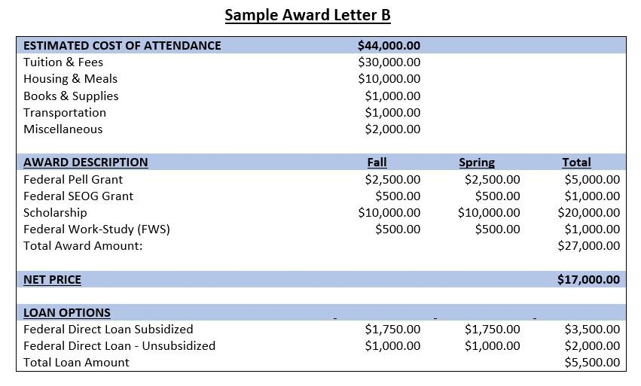

Slide 23
What if I still need money?
Other resources after maximizing your financial aid offer

Slide 24
Outside Scholarships and the Finaid Office
Outside scholarships can be found by doing research on the internet. Check out my Scholarship Slide!
If you need to, you can look into applying for a private loan from a bank. Make sure you talk to your parents/guardians first before pursuing this option!
You can also find ways to pay your bill by speaking to the college’s financial aid office by telephone, email or making a visit. Sometimes explaining extenuating circumstances that have impacted your family recently can result in more financial help.
Typically, you can pay your balance on a monthly basis. Most people do this if you cannot pay it outright at the beginning of the semester

Slide 25
5
College Resources
Financial Aid office and your financial advisor

Slide 26
Financial Aid Resources
Financial Aid Office
When you begin college you will be given a financial advisor who is in charge of your case and if you need any aspects of your bill explained you can speak with them. You can find your advisor on your student portal along with your academic advisor.
Bursar Office
The bursar office handles your bill payment. They keep track of what has been charged to you and what you have paid. If something you have paid does not show up within 2 weeks or if you fail to make a payment you can become blocked from registering for the next semester and eventually have to leave school.

